Slide 1
Senior Exit Interview
Raul Ceballos

Slide 2
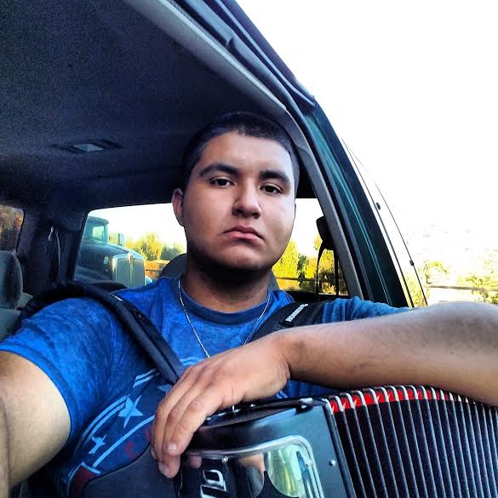
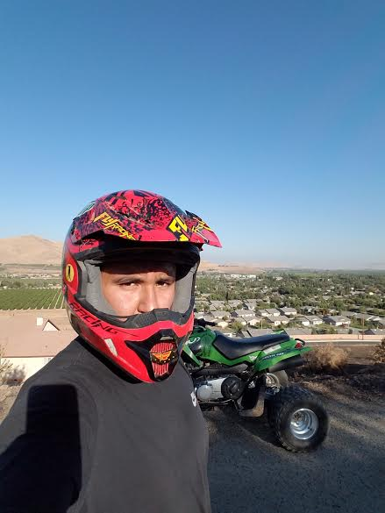
About me
I am 17 years old
born in lindsay, CA
Have 4 older sisters one younger sister and 3 older brothers and one younger brother
Like playing my accordion on my free time and riding my ATV

Slide 3
High school experience
High school has been an amazing experience for me
Performance based system has taught me how to be more responsible with turning in my work on time
New member to FFA
High school has prepared me for the world outside of school
“The real world”

Slide 4
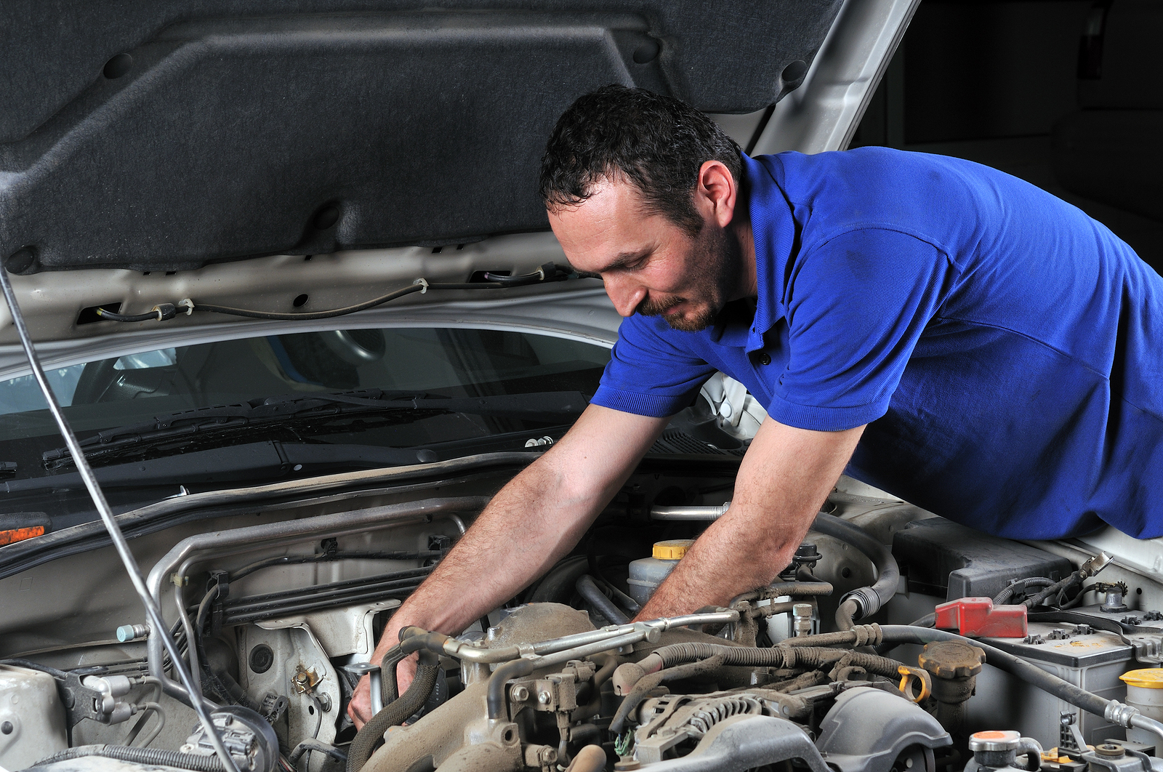
Job shadow
Gomez Auto Repair
614 E Honolulu St, Lindsay, CA 93247
I job shadowed Rafael Alvarez
After i did my job shadow here i realized Id rather fix and build houses

Slide 5
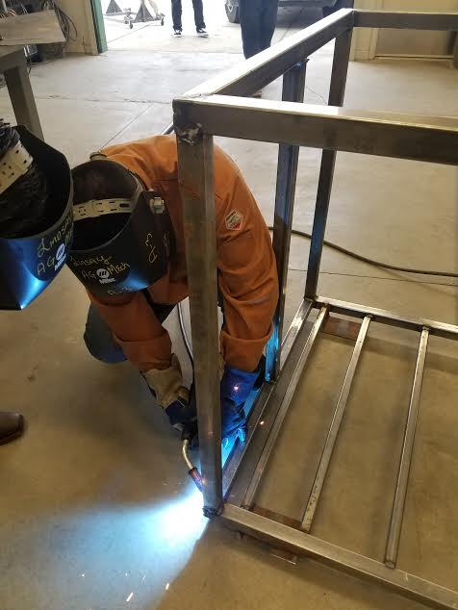
Pathway
I chose this pathway because i love working, building and fixing things
Like working with people as a team on projects
The experience will come in handy in the future to fix things of my own
Residential construction

Slide 6
Post-high school plans
I plan on working for a while after high school to save up money for college
Then eventually return to college
Plan on attending College of the Sequoias
After high school

Slide 7
Leaving high school
I am going to miss my friends
The teachers here have helped me grow into the person i am today
Thanks to Mr. Miguel for pushing me and motivating me through struggles in and out of school

Slide 8
Thankyou for your time
Any questions?

